Slide 1
Increasing Donor Options Without Increasing Liability:
A When to (and How to) Guide to Gift Acceptance Policies

Slide 2
An Overview
Gift acceptance policies serve three critical roles:
They expand donor gift options - because they expand the types of assets donors can use.
They create discipline in gift acceptance, helping the charity to manage liability.
The process of adoption expands the board’s perspective of the options and potential to raise funds.

Slide 3
An Overview
Nonprofits have one thing in common: you all accept charitable contributions.
Donors are increasingly considering non-cash gifts because:
They are holding onto cash
They’re making smarter gifts using long-term appreciated property
They’re using assets that do not generate income
They’re realizing they may be able to make a larger gift if they expand their options beyond cash

Slide 4
An Overview
If donors want to give you more than cash, you must be prepared to analyze and accept these non-cash gifts
For traditional nonprofits, gift acceptance policies are not generally adopted when a nonprofit is created - they are adopted later, as the fundraising program matures. And then, sometimes, they drift out of view.
This session is designed to help you understand the role, function, and content of good gift acceptance policies.

Slide 5
Developing a Perspective

Slide 6
Personal Observations
Here’s what I find:
Lack of policies for non-marketable assets
Bare bones policies – but no one uses them
Lack of standards for evaluation
History of “bad” gifts (sometimes they realize it, sometimes they don’t)
Lack of communication between finance and development
Tension between finance and development

Slide 7
Who’s Involved in Developing Policies
The development staff goals:
Expand gift options
Streamline process
Good execution from finance
Feedback on execution for donors
The finance staff goals:
Remove uncertainty
Manage liability
Manage staff time wisely

Slide 8
The Players
Finance staff preferences:
“We don’t want real estate – just give us cash”
“Why doesn’t the donor just sell the asset and give us cash?”
“We just don’t take tangible property”
“Why would we offer gift annuities? We have to register.”

Slide 9
The Board and Leadership
Gift acceptance policies allow you to address the needs of both finance and development
They also offer an opportunity to get in front of the board

Slide 10
A Diagnostic Checklist
Do you have a current set of gift acceptance policies?
If “yes”:
When were they adopted?
How often do you review them and make changes?
Recent legislation has dramatically changed the rules for some types of gifts – do your policies reflect these changes?

Slide 11
A Diagnostic Checklist
Do you have a current set of gift acceptance policies?
If “no”:
Does this create problems for you in timely review and acceptance of gifts?
Have you accepted gifts that had problems (liability)?

Slide 12
A Diagnostic Checklist
Have you ever had to decline a gift because of a lack of policies?
Do you have any limitations on the types of gifts you will accept?
Who on staff makes the ultimate decision on gift acceptance?
Which board committee has responsibility for gift acceptance/gift acceptance policies?

Slide 13
A Diagnostic Checklist
Is there any tension between the finance office and the development office when non-marketable gifts are offered?

Slide 14
Purpose And Role Of Gift Acceptance Policies
Gift acceptance policies provide discipline
type of assets
form of gifts
role of the nonprofit
Speech therapy to help the charity form the word “no”

Slide 15
Purpose And Role Of Gift Acceptance Policies
Policies help to educate staff and board about critical issues related to fiduciary duty
Must work through issues to make decisions
Helps board appreciate staff issues, practical issues, and legal issues
Policies are a way to educate/cultivate board about gift alternatives

Slide 16
Purpose And Role Of Gift Acceptance Policies
Polices add focus and strength to gift administration
Anticipate issues/make sound decisions
Have answers for donors
Helps charities avoid the green-eyed monster

Slide 17
Here’s a Thought...
Policies should be in place before the first gift is accepted
Why?
Case by case decisions breed inconsistency
Blinding glare of potential gift
Mixed signals to donors
Prevent donors from making mistakes

Slide 18
Drafting And Adopting The Policies
Collaborative process – I recommend a task force
planned giving/development staff
director/president
board committee
professional advisory committee
The consultant

Slide 19
Drafting And Adopting The Policies
Approved and adopted by board
Reviewed annually
Procedure for deviation
Professional backup

Slide 20
The Critical Elements of the Policies

Slide 21
The Critical Elements of Policies
Sample policies are attached.
Begin with a form, but customize.
Pay particular attention to the dangerous issues.

Slide 22
Before We Begin- The Terminology
Which organization affected
“Nonprofit” or “Foundation”
Committee with responsibility
Executive committee
Finance committee
Development committee
Planned gifts committee

Slide 23
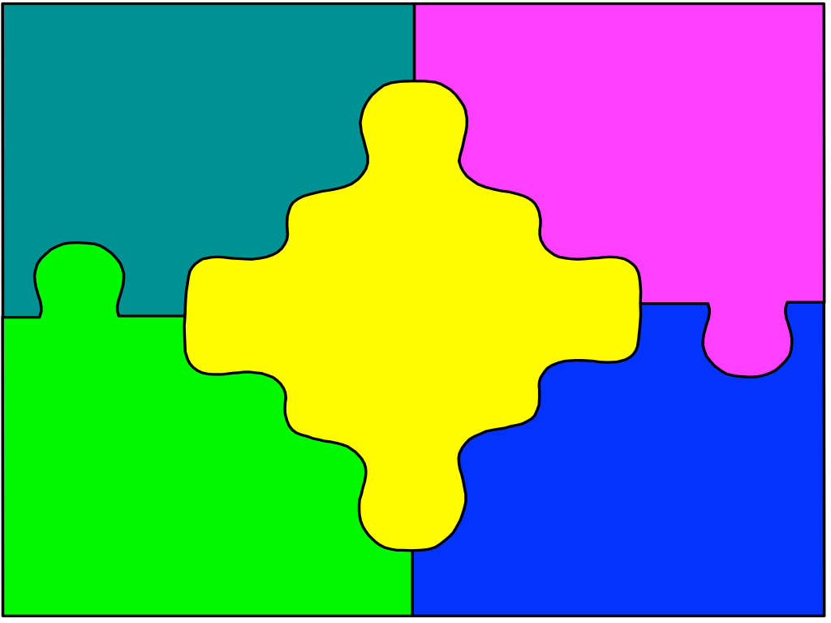
Mission And Purpose
Keep mission and purpose in front of decision makers
Gifts, and ultimate use of gifts, should reflect mission and purpose of organization

Slide 24
Purpose Of Policies And Guidelines
Purpose should be clearly stated
Govern acceptance of gifts
Provide guidance to donors
Provide guidance to professional advisors
Discharge fiduciary responsibility
Protect board from third party liability and IRS sanctions
Avoid unanticipated costs
Prevent negative publicity

Slide 25
Use Of Legal Counsel
Is it necessary to state the obvious?
Expenses unbudgeted
Organizations unwilling to spend $$

Slide 26
Use Of Legal Counsel: What Should It Say?
Use counsel when appropriate
List circumstances under which counsel is engaged
Review of specific gifts
Review of all gifts to which charity is a party
Review of all transactions with COI
Other

Slide 27
Use Of Legal Counsel: What Should It Say?
State that outside counsel should be used to avoid conflict of interest
Difficult to separate counsel role from board role
Difficult for board to take advice from insider
Personal benefit issues
Acknowledge that use of counsel is part of the fiduciary duty

Slide 28
Donor Conflict Of Interest
Donors should seek independent counsel
Reference and attach Model Standards, AFP’s Donor Bill of Rights, and any other relevant standards

Slide 29
Donor Conflict Of Interest
Understand that most conflicts occur when there are close relationships, not new relationships
Discuss donor conflict issues with the board
Especially important in light of current Congressional scrutiny and Sarbanes-Oxley

Slide 30
Restrictions On Gifts
You may prefer unrestricted, but donors want to vision
Anticipate how to handle restricted gifts at your institution (type, size, maturity)
no restrictions
endowment pools for specific purposes
gifts that fit mission and purposes, not too difficult to administer

Slide 31
The Gift Acceptance Committee
Group should be integral part of governance structure
Small enough to act on timely basis
Consistent, educated process

Slide 32
Types Of Gifts
Cash
Tangible Personal Property
Marketable Securities
Non-marketable Securities
Real Estate
Remainder Interests In Farm Or Home
Oil, Gas And Mineral Interests
Bargain Sales
Life Insurance
Intellectual Property
Charitable Gift Annuities
Pooled Income Funds
Beneficiary Designations

Slide 33
Cash
Form isn’t an issue
Purpose may be an issue

Slide 34
Tangible Personal Property

Slide 35
Tangible Personal Property
Art
Furniture
Equipment
Coin and stamp collections
Livestock
Jewelry
Acceptance/title
Acknowledgment
Valuation
Costs of holding
Safeguarding
Marketability

Slide 36
Criteria For Tangible Personal Property
Does the property fulfill the mission of the nonprofit? (related use)
Is the property marketable? What are the costs?
Are there any undue restrictions on the use, display or sale of the property?
Are there carrying costs? (insurance, lease space, maintenance to preserve value, appraisal for sale purposes?)

Slide 37
Changes in the Law
Rules on recapture
Rules on vehicle donations
Stricter rules on qualified appraisers
Zeal in Washington

Slide 38
Marketable Securities
Purpose/use of the gift
Timing of the gift
Timing of the transfer
Timing of the sale

Slide 39
Non-Marketable Securities
For purposes of this discussion, this includes corporate (C and S) stock, corporate bonds, partnership interests, LLC’s, LLP’s
Issues:
restrictions on security
marketability
undesirable tax consequences

Slide 40
Non-Marketable Securities
Review by legal counsel
Review by accounting counsel
Acceptance by committee

Slide 41
Real Estate
One of the most dangerous gifts for charity- one of the most common assets for donors
Three issues:
Environmental liability
Criteria for acceptance
Type of gift funded

Slide 42
Real Estate - Environmental Liability
Comprehensive Environmental Response, Compensation and Liability Act (CERCLA)
Enacted in December 1980 - but timeless
Responsible parties are jointly and severally liability
Two impacts:
Outright ownership
Trustee relationships

Slide 43
Real Estate - Criteria
Is the property useful for the purposes of the nonprofit?
Is the property marketable?
Are there any restrictions, reservations, easements, or other limitations?

Slide 44
Real Estate - Criteria
Are there carrying costs? (insurance, property taxes, mortgages, notes, etc.)
Is there a clean environmental audit?

Slide 45
Real Estate - Type of Gift
Charitable remainder trust
Is it an annuity or unitrust?
Does it flip?
Is the property mortgaged (NO!)
Is the property the donor’s home?
Pooled income fund
Charitable gift annuities

Slide 46
Remainder Interests in Home Or Farm
This is a gift of real property - must comply with real estate provisions
Set policy for capital improvements, upkeep, taxes
Set policy for early termination if home sold

Slide 47
Oil And Gas Interests
More active in some segments of the country than others
Generally working interests or fractional participations
Issues: valuation, partial interest, liability, marketability, predictability

Slide 48
Bargain Sales - Criteria
Will the property be used by the nonprofit or sold?
Environmental review
Condition of the property
Ratio of debt to equity
Ability to cash flow the debt
Carrying costs (insurance, taxes, maintenance)
Impact on donor (trigger tax)

Slide 49
Life Insurance
Two basic types of transfers
Transfer of old policy
Transfer of cash for new
What do you do on receipt?
Continue to make premium payments
Conversion of the policy to paid up, other elections
Exchange for cash value
Sale to viatical company

Slide 50
Intellectual Property
Royalties
Patents
Copyrights
Contract Rights
New laws on charitable deduction

Slide 51
Charitable Gift Annuities
Organization must have assets and ability to comply with the law
Organization must have administrative resources
Board must understand liability

Slide 52
Charitable Gift Annuities
Policies must address:
Minimum and maximum size of charitable gift annuity
Minimum and maximum age of annuitants
Types of CGAs to be offered
Types of property accepted
States in which donors may execute
Manner in which assets are administered

Slide 53
Trustee Appointments
Should you ever serve as trustee?
The issues if you do serve:
State law
Fiduciary obligations
Exposure to liability

Slide 54
Beneficiary Designations
Insurance policy designations
Retirement plan designations

Slide 55
The Phone Log
Cows
Farm equipment
Frequent flyer miles
Gold coins
Leased property
Partnership interests, limited and general
Patents (excluded from UBIT under Section 512(b)(2))
Savings bonds
Time share interests

Slide 56
Miscellaneous Issues
Appraisals
Legal fees and professional fees
Valuation of gifts on the nonprofit books
Filing of IRS forms
Acknowledgement of gifts
Changes to policies

Slide 57
Attachments or References
NCPG Model Standards
AFP Donor Bill of Rights
Environmental Audit
Form 8283 and Instructions
Form 8282 and Instructions
Publication 526 - Charitable Contributions
Publication 561 - Valuation of Gifts

Slide 58
Cautionary Tales: Stories of Disaster

Slide 59
Cautionary Tales
Review of policies is tedious in the abstract
Use cautionary tales : the importance of learning through other organization’s disasters rather than your own

Slide 60
The Very Bad Personal Property Gifts
The donor and the large orange pot
The 53-foot Hatteras - “Boat: a hole in the water into which you pour your money.”
The campaign pledge and the ring

Slide 61
The Even Worse Gift Of Real Estate
The two paint factory nightmare
The house with that something extra
The two-year promise (complete with a reserved seat in the IRS penalty box)

Slide 62
The Ungrateful (Shall We Say Angry?) Donors
The painting to pay off the capital campaign pledge
The mutual fund gift that wandered in late

Slide 63
Finally Finished! Or Are You?
Review at least annually
Make changes where necessary
Involve committees of your board
Educate
Preach!
Tell those cautionary tales

