Slide 1
Financial Resource Development & The Board’s Role in Securing Legacy Gifts

Slide 2
GOALS
Understand where legacy gifts fit into overall FRD
Understand the legacy development cycle
Understand how you can help
Identify and share your preferences
Notes:
Review the text on the slide and explain what helping means
Helping includes identifying prospects, cultivating potential donor, having legacy conversations, listening for specific cues and stewarding those you chose to leave a legacy or contribute cash to our endowment.

Slide 3
Development Activities
TODAY
Annual
TOMORROW
Specialty
Capital
FOREVER
Permanent Endowment
Cash today
Legacy gifts
Notes:
Today:
Annual - Ongoing current expenses
Tomorrow:
Specialty - Specific purposes
Capital - Facility and physical needs
Forever
Permanent Endowment - Sustainability
Outright
Legacy
while each of these development efforts require a different type of conversation , the one asking has to know who they are talking to and what kind of gift they are asking for, along with understanding how the different kinds of gifts contribute to the overall capacity of the org to do its work.

Slide 4
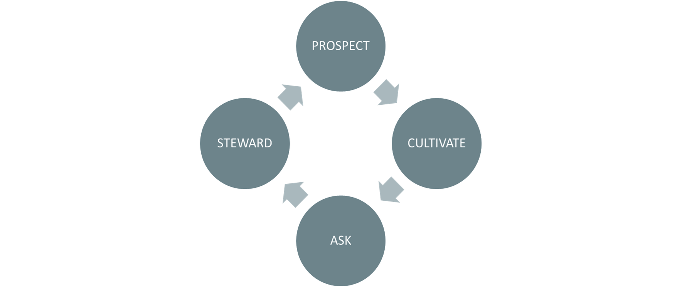
Annual Development Cycle
Notes:
Review the cycle information on the slide

Slide 5
Legacy Development Cycle
Prospect
Steward
Cultivate
Formalize
Ask (Letter of Intent)
Steward
Notes:
Review the cycle on the slide

Slide 6
How are legacy gifts different than current cash gifts?
No cost to the donor now
Committed annual donors
Education is key
Conversations less transactional
Letter of intent
Stewardship critical
Formalized commitment
Notes:
No cost to the donor now
Legacy donors are most often already committed annual donors
Cultivation and education is needed for the donor to understand what a legacy gift is and how to make it
Work on building a stronger relationship with our donors – have deeper conversations rather than just asking donor to increase what they gave last year as is usually done in annual campaign
Sometimes legacy commitments require more than one conversation and donors need time to talk to advisors and family before agreeing to make a commitment
First step is to secure a letter of intent and give the donor time to determine the appropriate vehicle for their gift
Donors must be stewarded several times every year for their lifetime to make sure they feel appreciated, stay engaged, understand the impact their legacy gift will have – so they don’t change their mind
Must have a second conversation with the donor at the appropriate time to move them to legally put their commitment in place.

Slide 7
Identifying Legacy Donors
Can be of any age
Long-term consistent donors & volunteers
Already connected and committed to organization
Care about the Jewish future and supporting next generation
Want the impact this organization has had on their life to be available for others
Notes:
Legacy donors can be of any age
Long-term consistent donors and volunteers make the best prospects
YOU can help us identify donors who are already connected to and committed to the work we do
YOU can help identify donors who care about the Jewish future and the next generation
YOU can help us identify individuals who want the impact we have had on their life to be available to others.
Please Share information about prospects interests or backgrounds that might be helpful
Pass on helpful information about a potential donor that you learn in conversation such as the sale of a business, the sale of a 2nd home, active estate planning etc. [See Planned Giving Conversational Clues.]

Slide 8
Cultivating
Learn donor’s story
Nurture relationship
Engage in organizational activities
Educate about importance of building endowment
Educate about legacy giving
Share why you chose to leave a legacy
Notes:
Learn the donor’s story
Nurture the relationship
Invite prospects to events and programs
Educate about the importance of building our endowment
Educate about legacy giving and the LIFE & LEGACY initiative
Share your story about your involvement and why you became a legacy donor

Slide 9
Having legacy conversations
Ask meaningful questions
Understand donor’s connection
Ask them to join you in leaving a legacy
Wait for their response
Complete conversation
Follow-up as necessary
Secure letter of intent
*If you are willing to have conversations with prospects, we can provide you with additional training and support
Notes:
The legacy conversation involves several steps
First we ask some meaningful conversations to get the donor/member sharing why our organization is important to them and the impact it has had on their life
This is so we can better understand their connection to us
Once we have this understanding, then we ask them to join us in leaving a legacy
Waiting for their response can be challenging, but we want to be silent and give them time to think. We don’t need to keep pitching the concept to them
Once they response, then we can complete the conversation with them – either sharing the letter of intent form, answering questions they might have, agreeing to have a second conversation after they have thought about it.
Ultimately our goal is to secure an intent form.
If you are willing to help us have legacy conversations, we can provide you with the additional training and resources you need to get comfortable.
It is fun and rewarding and another way for you to leave a legacy.

Slide 10
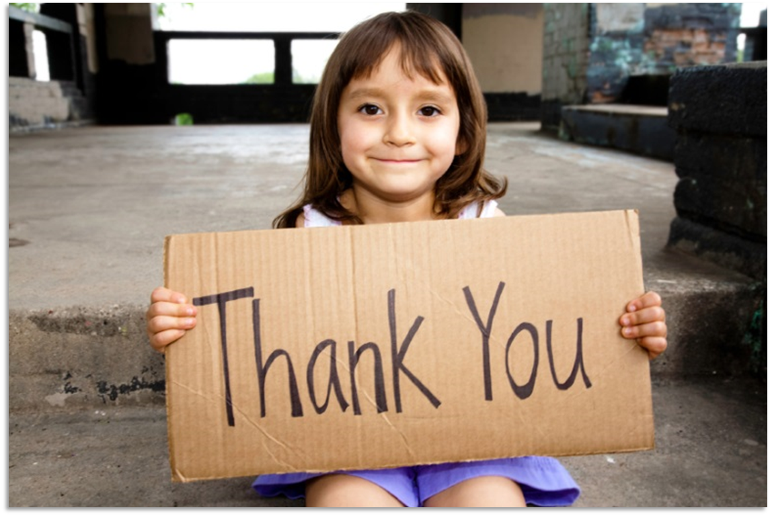
Effective Stewardship
Care – personal connections
Share – lists & testimonials
Invite – events for legacy donors
Honor – honor donors at organizational events
Notes:
Donors matter. When donors feel that, then they are being effectively stewarded. When we have robust stewardship, people are more likely to engage and feel more a part of achieving the mission. This will make them more generous with their time, talent and treasure.
We steward donors when we:
Care - Showing personal thanks
Share - Listing donors, acknowledging them at events, sharing testimonials, etc.
Honor - Honoring donors at general events
Invite - Inviting donors to events especially for them
LIFE & LEGACY recommend doing this four times, every year, for the donor’s lifetime.

Slide 11
Formalizaton
Moving the donor to legally put their legacy commitment in place
Notes:
Once a donor has signed a letter of intent form – they will advise us as to how much time they need to legally put their commitment in place.
When the appropriate time has passed, we go back to them to have another conversation to move them to formalize their commitment – if they haven’t already done so.

Slide 12
Which part of the legacy development cycle is most comfortable for you?
Developing prospect list
Cultivating
Having conversations
Stewardship
Notes:
It is critically important in terms of our success in building our endowment that the board be ambassadors for legacy giving. Which part of the legacy development cycle is most comfortable for you?
Prospect – You know a lot of people and can help identify people who feel warmly about the organization.
Cultivate/educate – You understand how legacy will benefit the organization and enjoy educating people about legacy giving.
Have conversations – You enjoy listening and talking to others, asking about their connection to the organization and inviting them to make a legacy gift.
Steward – You enjoy thanking others. You like writing stories about impact. You like making people feel valued and good about their giving.
Please think about the role you can play

Slide 13
Questions
Notes:
Ask if any questions at this point and respond

Slide 14
Notes:
Share with the board your next steps – are you going to reach out to them individually to see what role they want to play? Are you going to get people to commit at this meeting – at the next? Share your plans for securing legacy gifts and stewarding donors over the next few months.

Slide 15
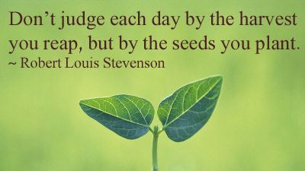
Notes:
It is important to remember that every conversation you have about legacy giving is planting a seed for a future gift. Share your reasons for leaving a legacy with others and encourage them to join you. This is the work that will make all the difference in terms of building our endowment and securing our financial future.

Slide 16
Thank you

