Slide 1
BUILDING OUR ENDOWMENT THROUGH LEGACY GIVING

Slide 2
WHY…
have you chosen to give your time, energy and financial resources to our organization?
Notes:
This is a “warm up” question to get everybody focused on the topic at hand and to understand their connection to your organization

Slide 3
A STORY
What this organization means to me
Why I made a legacy commitment
Notes:
Have the Legacy Committee Chair or Board President share what the organization means to them and why they chose to leave a legacy

Slide 4
OUR FUTURE WELL-BEING
Did you know that X% of our operating budget comes from our endowment?
It has been recommended that 20% of an organization's operating budget come from their endowment by 2030 in order to avoid fiscal crisis
If we want 20% of our annual revenue to come from our endowment, we need to work towards securing $X in endowment funds – either through current cash gifts or after-lifetime commitments.
Building our endowment through legacy gifts will provide financial stability
Notes:
Did you know that X% of our operating budget comes from our endowment?
Independent professional advisors recommend organizations be prepared to have 20% of their annual budget come from endowment funds by 2030 in order to avoid a fiscal crisis.
For a budget of $1,000,000, 20% of revenue coming from an Endowment would provide $200,000 a year. In this scenario, estimating a 4-5% payout, the endowment fund would need to be at $4,000,000. Given current investment strategies with lower than 4-5% payout, the endowment would need to be larger.
Based on our expenses of $[X], if we want 20% of our revenue to come from our Endowment that would be $[X]. Assuming a 5% payout, we should have an Endowment of $[X].

Slide 5
WHY LEGACY?
Legacy giving will help sustain our organization for future generations
$59 trillion transfer of wealth
Donors leaving gifts to other organizations because they were asked
We need to offer our loyal donors the opportunity to ensure our organization continues to impact the next generation the same way it has impacted them.
Notes:
Legacy giving will help sustain our organization for future generations.
A $59 trillion transfer of wealth from one generation to the next is currently taking place. Donors are leaving current and after-life gifts to universities, colleges, hospitals, and arts organization.
While we have had a huge impact in our constituents’ lives, few consider leaving after-lifetime assets to us usually because we don’t ask.
As we engage in meaningful legacy conversations with our constituents and encourage them to evaluate and share the importance of our organization in their lives, we offer them the opportunity to ensure the organization continues to impact the next generation in a similar way.

Slide 6
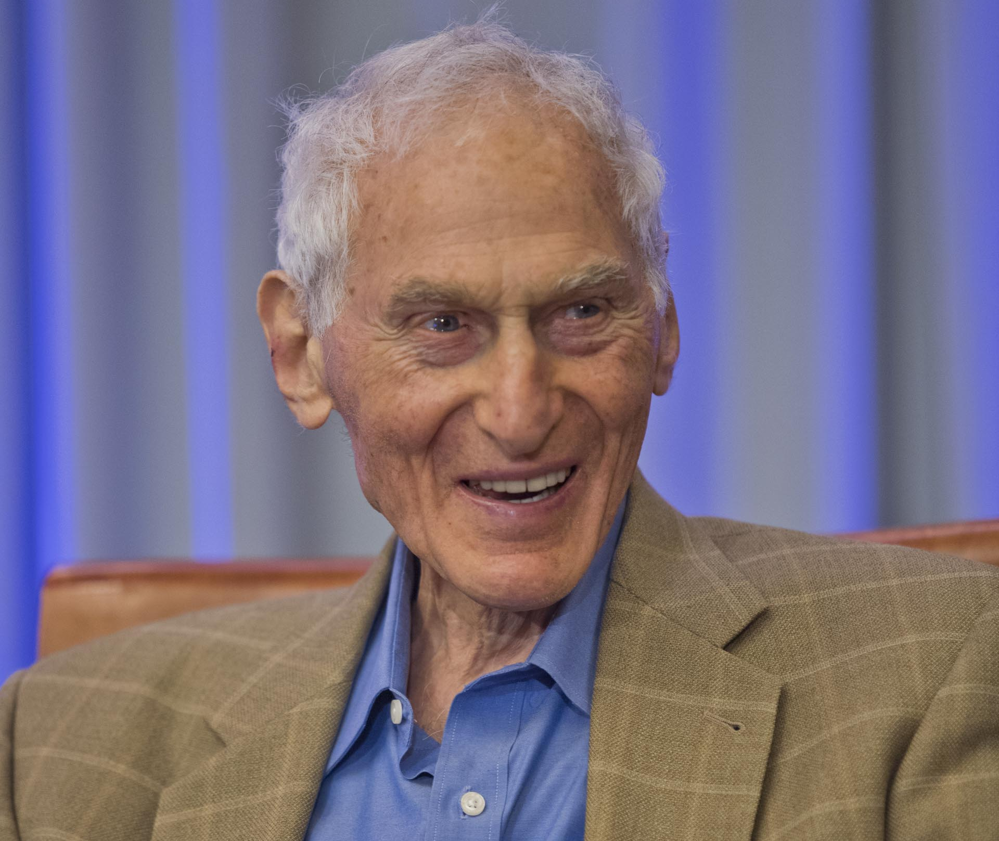
LIFE & LEGACY
A program of the Harold Grinspoon Foundation to help us build our endowment
Notes:
We are participating in program sponsored by the Federation/Jewish Community Foundation and the Harold Grinspoon Foundation.
LIFE & LEGACY is a 8–year partnership program including training, support and monetary incentives to assist communities across North America to promote after-lifetime giving in order to build the endowments of valued Jewish organizations.
We will receive training and support to integrate legacy into the philanthropic culture of our organization.
We have the opportunity to receive an incentive grant if we secure a minimum of 18 legacy commitments each year for the next two years, and an additional grant if we reach 25. (For those who are in Year 1 and 2)

Slide 7
LEGACY DONORS
Anyone can be a legacy donor
The gift can be any amount
The gift comes from after-lifetime wealth
The gift can be designated in a will or trust, or as a beneficiary of a retirement account, life insurance policy or donor advised fund.
Lots of options to choose from!

Slide 8
WHY YOUR GIFT MATTERS
Help build our endowment and be a role model for others
The XXX Federation/Jewish Community Foundation and LIFE & LEGACY are supporting us in this effort
We are building a philanthropic culture
Incentive grants are available when we reach our goals
Notes:
Your legacy gift will make a difference to build our endowment and to be a model to others to make their legacy gifts.
LIFE & LEGACY and our local Federation/Foundation are supporting us in this effort by offering training, support and monetary incentives.
We are building a philanthropic culture that recognizes that all giving strengthens our ability to best meet our mission.
We can earn unrestricted incentive money when we reach our goals.

Slide 9
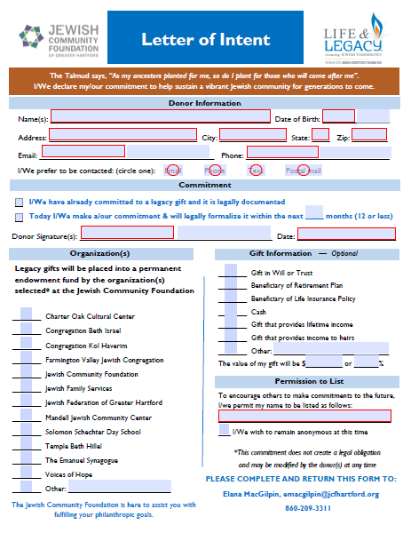
LETTER OF INTENT

Slide 10
WHY WE NEED YOU!
Board needs to provide momentum to this effort
Make your own commitment
Support the legacy team
Encourage others to make legacy gifts

Slide 11
NEXT STEPS
Working to make our organization financially stable
We work to make decisions that are best for the organization’s health and future
We serve as role models for our donors and community
The legacy team will follow up with everyone individually
We will report at future board meetings
Our goal is to have 100% board participation
Notes:
As board members, we work to make decisions that are best for the organization’s health and future. This the way we work toward making the organization financially sustainable.
As the leaders of this organization, you serve as role models for the rest of our donors and community.
We will be following up with each of you individually and reporting at future board meetings on our endowment building progress and legacy giving initiative.
Our goal is to have 100% board participation and by committing now, you will help us secure the incentive grant offered as part of the LIFE & LEGACY initiative. (For those who are in Year 1)

Slide 12
THANK YOU!
Notes:
Answer questions and offer concluding remarks of gratitude for each members service

